Slide 1

Community Driven Development

Slide 2

In this chapter you will learn about:
Various tools used in an open source software development project.
Processes of designing and writing the programs.
Managing different versions of the source code and creating new builds.
Methods of testing and issues tracking.
How open source software is released.

Slide 3

The Big Picture
A community is a diverse group of people sharing their thoughts, ideas, work, and experiences, at a common place.

Slide 4
Community Driven Development
In the software industry, community driven development broadly means an initiative under which a group of technologists work together with a common vision of producing open source software.
Notes:
Framework – follow a set of standards set by the framework – you take advantag of the native features (Templating…etc)
Faster – loads only what It needs

Slide 5

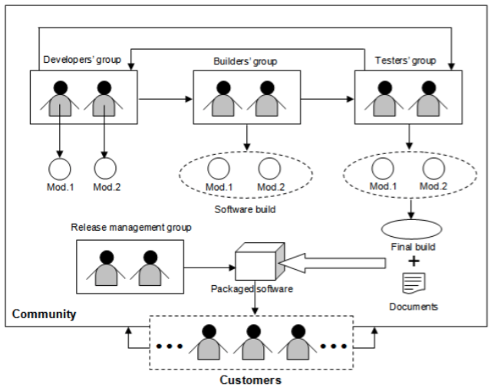
Community Driven Development
Notes:
Figure 4.1 gives you an overview of such a community, where multiple sub teams collaborate to develop open source software.
As shown in the figure, the developers' group is responsible for writing code for different independent modules of the software.
The builders’ group takes these modules from the developers and put them together to build a new version of the software.
These software builds are internally tested by the testers' group.

Slide 6
Community Driven Development
As shown in the figure, the developers' group is responsible for writing code for different independent modules of the software.
The builders’ group takes these modules from the developers and put them together to build a new version of the software.
These software builds are internally tested by the testers' group.
Notes:
In case a bug or failure is found, they report back to the appropriate developer who debugs the code and includes a proper fix.
This is an iterative process that repeats itself until the product satisfies all its requirements and becomes error free to the maximum possible extent.

Slide 7
Community Driven Development
Once the objectives of the project are met, the release management group packs together the final version (final build) of the software with all the necessary documents, and then hands it over to the customers.
Notes:
In case a bug or failure is found, they report back to the appropriate developer who debugs the code and includes a proper fix.
This is an iterative process that repeats itself until the product satisfies all its requirements and becomes error free to the maximum possible extent.

Slide 8
Community Driven Development
Software development tools are a collection of programs that help with specific tasks during the software development life cycle.
They are normally used for project management, and to perform repetitive, and time consuming tasks.
There exist both, proprietary and open source development tools.
Notes:
obvious that the latter one is the preferred choice. There are also a few instances, where communities use their self developed tools.

Slide 9

Developers' Group
Software design and development

Slide 10
Software Design and Development
You can think of software design as the blueprint that defines the architecture and behavior of a product
Coding as the process of implementing the design.
A community driven software development typically starts as a project to address problems generic across the society.

Slide 11
Software Design and Development
These problems are technically termed pain points: include a list of requirements that the software is expected to fulfill.
The designers’ group, which in many cases is also part of the developers' group, takes these requirements as input and writes algorithms which are cost effective and optimal in terms of performance.

Slide 12
Software Design and Development
Software designers should be the most experienced and knowledgeable members of the community as their job requires thorough understanding of the entire system.
They also must be aware of every alternative to overcome all the probable barriers of implementing the design.

Slide 13
2 Important Points
Hardware
Operating System
Notes:
1. The designer must know the capabilities of the hardware, with which the software is going to interact.
Resources like number and speed of the processors, I/O device response time, available system cache, primary memory and secondary storage space etc. are the most important concerns.
2. The operating system (OS) provides the environment for running applications. Process and thread handling mechanisms vary from one OS to another. Moreover, the algorithms of job scheduling, CPU time allocation, avoiding deadlock situations are also different. The designer must take these factors into account.

Slide 14
Software Design and Development
A perfect design should be self explanatory and easy to understand.
All the algorithms and flowcharts should include detailed explanations and other necessary documentations including time-space complexity and the expected behaviors of the system under best and worst scenarios.

Slide 15
Software Design and Development
Unified Modeling Language (UML) is a widely accepted standard used for software design.
It allows a designer to describe the structure, behavior, and interactions among different sub units of the system with the help of various simple diagrams.

Slide 16
Software Design and Development
Following design, the software development life cycle enters the coding phase.
At this stage, the design is first sub divided into multiple smaller units.
Different development groups code these sub units separately as individual modules.

Slide 17
Software Design and Development
Coding is the process of translating the steps of an algorithm, into multiple computer instructions, with the help of a programming language.
Choosing the proper language for writing the source code is critical.
A community should always encourage using languages which have gained industry wide trust and with which the development team is well versed.
Notes:
Some communities prefer using interpreted languages, since they consume less time to create the executable modules as compared to the compiled languages.

Slide 18
Software Design and Development
Transition between the design and code generation phases in a community driven development typically tend to overlap with each other in a project.
Developers sometimes start coding parts of a system, while other parts are yet to be designed.
Although, this kind of approach of running two phases in parallel saves time; it may result in duplication of effort in the event of a change in design.
Notes:
Some communities prefer using interpreted languages, since they consume less time to create the executable modules as compared to the compiled languages.

Slide 19
Version Control

Slide 20
Version Control
Software development is an incremental process where functionality is added or removed one by one.
At any given time the code of different modules may undergo frequent modifications by different individuals or groups which create different versions of the same code.
Version control (or revision control) is the mechanism to manage all of these versions in an effective way.

Slide 21
Centralized Version Control System (CVCS)
It works in a centralized manner which means that developers and testers around the world have to connect to a server, where a central repository for the entire project is stored.

Slide 22
Concurrent Versions System (CVS)
a very well known open source CVCS
To get a private copy of a particular file, you first need to check it out from the repository.
Once done with your changes, you may commit or save your work into the repository by checking the file in.
CVS will automatically increment the version (or revision) number by 1 and record all the necessary information about the change in its log.

Slide 23
Concurrent Versions System (CVS)
If someone else had already committed some other changes to the same file, CVS will automatically merge your changes with those of the other person.
This system also allows a user to track back the old versions of a file.
By comparing two successive versions of a file, you can easily determine modifications introduced.
Notes:
One of the main drawbacks of CVCS is that developers may interfere with each other's working environment.
For example, a small bug injected through a code change, becomes a big issue when it causes various other modules of the entire code base to fail.

Slide 24
Decentralized / Distributed Version Control System (DVCS)
This type of version control allows a developer or tester to create their own code branch
they can maintain versions of the code in a decentralized manner
A DVCS provides all the functionalities of CVCS, plus the flexibility of creating a local repository
Git, Bazaar, Monotone, Mercurial and Darcs are a few examples of open source DVCS software.

Slide 25
Did you know?
During the early days of Linux® kernel development, Linus Torvalds used CVS for version management.
In 2002, Linus switched to BitKeeper; however, since BitKeeper became proprietary in 2005, Linus started writing a completely new DVCS, called git.

Slide 26
Builders' Group
Software building

Slide 27
Software Building
Programs are normally written in smaller units that are compiled before they can be executed.
The resulting object modules are then bound together in a process known as linking to form a complete software system.
Software building refers to the sum of compiling and linking all the source code of a project.

Slide 28
Software Building
Software building is a dynamic process: People constantly add, delete and modify the source code files under the project’s central repository.
To make these changes effective, the modified code needs to be recompiled and linked regularly.
Development communities generally have a separate build team to carry out this task.
Notes:
It is important to mention that the build process recompiles only those source code files which were modified since the previous build was released.

Slide 29
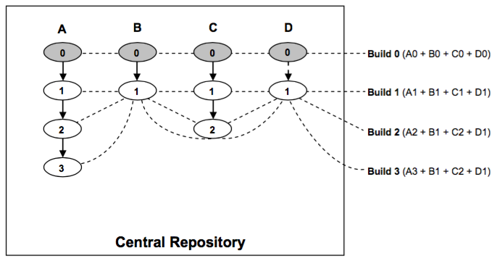
Software Builds
Notes:
It is important to mention that the build process recompiles only those source code files which were modified since the previous build was released.
For the rest of the elements which remained unchanged, the older compiled modules are picked up.

Slide 30
Software Builds
Private
Integration
Release
Notes:
Private build – A private build is a new version of a developer’s personal branch in a DVCS. Naturally, this type of build is only visible to its owner and he can access it locally even when working offline.
Integration build – An integration build is created from the compilation and linking of the main project branch and is available to all within the community for use.
Release build – A release build is the final version of the software to be shipped. It is basically a snapshot of a stable integration build which users use as a product.

Slide 31
Private Build
A private build is a new version of a developer’s personal branch in a DVCS.
Naturally, this type of build is only visible to its owner and he can access it locally even when working offline.
Notes:
It is important to mention that the build process recompiles only those source code files which were modified since the previous build was released.

Slide 32
Integration Build
An integration build is created from the compilation and linking of the main project branch and is available to all within the community for use.

Slide 33
Release Build
A release build is the final version of the software to be shipped.
It is basically a snapshot of a stable integration build which users use as a product.
Notes:
Frequent builds allow the source code to undergo less number of modifications. This reduces the effort needed for debugging and fixing the new errors.

Slide 34
Testers' Group
Software Testing

Slide 35
Software Testing
the process of executing a program with the intent of finding errors
There are two varieties of software testing: black box and white box.

Slide 36
Black Box Testing
In this type of testing, the actual output of the code is compared with the expected result.
Testers are supposed to feed the system with a set of inputs, and note down the corresponding outputs.
In case of any mismatch between the obtained and expected results they report it to the developer without analyzing the code.

Slide 37
White Box Testing
The testers look into the source code of the product and carry out some investigation in the event of failures.
This requires a developer to put less effort and time for analyzing the error before fixing it.
Notes:
With open source software, every person, no matter whether he is a member of the community or not, gets equal opportunity of performing white box testing as the source code is accessible to all.

Slide 38
Levels of Testing
Unit Test
Integration
System
Alpha
Beta

Slide 39
Levels of Testing
Unit testing: This level is used to test individually each of the units that make up a software
Integration testing: In this level, all the stable modules are integrated with each other to form the entire system, and tested as a whole.
System testing: This testing ensures the software is operational and satisfying all its requirements.

Slide 40
Levels of Testing
Alpha testing: the software is given to the users internal to the community, to judge its performance against practical deployment.
Beta testing: After fixing the errors discovered during alpha testing, the community releases the software to the external users as a beta version, with a disclaimer that it may fail in unplanned use cases.
Notes:
The community expects external users to provide feedback about these unplanned scenarios.

Slide 41
Software Testing
When a bug is encountered, the user will normally poke through the code to make things work again, or he can customize it to his own needs.
This is the way in which many people become members of OSS communities.
When the software becomes so useful and with enough followers, some users take the software to the next level by enhancing it, and formally releasing it to the community.

Slide 42
Software Testing
OSS development often spends less time and budget to test their product.
Rather, they leverage the community to test and fix the code themselves; and to provide feedback for new functionality.
In addition, this unique approach makes open source software very robust.

Slide 43
Release Management Group
Packaging

Slide 44
Release Management Group
In an open source software, the core item of a package is the source code.
A standard package includes accessories like an installation guide, a user manual, and other information.
Packages of software written in high level languages like C or C++ that require compilation of the source code, optionally may contain a pre-compiled executable version of the product.
Notes:
Users give preference to a product that is well packaged.

Slide 45
Release Management Group
Releasing

Slide 46
Release Management Group
Releasing software means making a completely new or upgraded version of a software available to the users.
A new release introduces a product into the market and an upgraded version provides fixes for errors found in a previous released version and optionally adds new features.
Notes:
Users give preference to a product that is well packaged.

Slide 47
Release Management Group
The file extensions: .tar, .gz, .zip
Abcdefg x.y.z < Alpha | Beta >
Abcdefg is the name of the software
x, y, and z represent the major, minor and micro
Notes:
To distinguish the versions from each other, each OSS community follows its own convention of using unique numbers for every release.

Slide 48
Release Management Group
With sufficient testing and debugging through alpha and beta cycles, the software finally becomes ready to be officially shipped.
At this conclusive stage, the community announces:
“General Availability (GA)” of their product.
Notes:
To distinguish the versions from each other, each OSS community follows its own convention of using unique numbers for every release.

Slide 49
After Release
The developers' group work is divided in two:
The first one is to maintain & support the already released version
The second one is to further improve the product with new functionalities to be included in the next version
Notes:
http://danielkummer.github.io/git-flow-cheatsheet/

Slide 50
After Release
Release Branch - maintenance works will occur
Stable snapshots of this branch are released as minor versions of the product at the same major line
Abcdefg 3.1.0, Abcdefg 3.2.0 and so on
Notes:
At this point, the central repository of the version control system is branched into two.
http://danielkummer.github.io/git-flow-cheatsheet/

Slide 51
After Release
Mainline Development Branch - developers work on the new version
This branch progresses in parallel with the release branch.
Notes:
At this point, the central repository of the version control system is branched into two.
http://danielkummer.github.io/git-flow-cheatsheet/

Slide 52
Issue Tracking

Slide 53
Issue Tracking
An issue may refer to a bug, but also to a change request, where the change is related to a piece of existing code, design, feature or even software documentation.
OSS projects typically use free issue tracking tools like Abuky, Bugzilla, Buggit, BugRat, GNATS, JitterBug, and Mantis.
Notes:
An issue can be discovered by a developer, a tester or even a user.

Slide 54
Issue Tracking
An issue can be discovered by a developer, a tester or even a user.
Once identified it is reported to the community by logging a record in the issue tracking database, managed by the tool, with all the necessary details.
Every single issue record is associated with a unique number for identification purpose.
Notes:
An issue can be discovered by a developer, a tester or even a user.

Slide 55
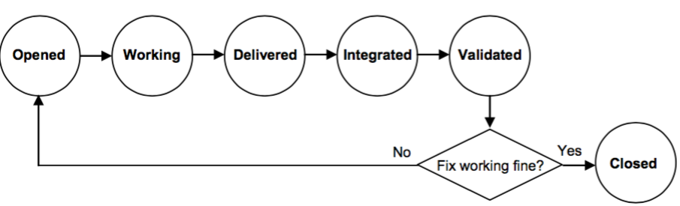
Life Cycle of an Issue
Notes:
When a person ("the originator") finds a problem, he logs a defect in the issue tracking database, and the state of the issue is set to opened.
Thereafter, someone from the development team tries to reproduce the error and takes ownership of the issue if he validates it is indeed a bug.
At that point the state of the issue is updated to working.
Once the developer (owner) fixes the problem, he commits the changes required into the central repository, and updates the state to delivered.
When these changes are included in the build of the project branch, the state changes to integrated.
If the build passes all the required tests, it is made available to the entire community and the issue state changes to validated.
The originator can now verify that the new build resolves the problem.
If the error reoccurs, the state is switched back to opened and the whole cycle starts again; otherwise, the issue is closed.

Slide 56
Summary
In this chapter, you learned how open source software is developed as a community initiative and how a project goes from an idea to a featured product.
The chapter discussed all the stages of the software development life cycle, such as designing, coding, testing, building, packaging and releasing; with focus on the different groups who participate at each stage, and also on the open source software tools used.
Notes:
An issue can be discovered by a developer, a tester or even a user.

Slide 57

Hello!
I am Ricky Noel
I am here because I love to give presentations.

Slide 58

INSTRUCTIONS FOR USE
Introduction
What you should know
Getting Started
Working with Models
Dividing your App into Partials
7 Reasons to Use AngularJS for Developing Your Next Web App

Slide 59
“Design is not just what it looks like and feels like. Design is how it works.”

Slide 60
What You Should Know
Let’s start with the first
set of slides

Slide 61
SlidesCarnival icons are editable shapes.
This means that you can:
Resize them without losing quality.
Change line color, width and style.
Isn’t that nice? :)
Examples:

Slide 62

What You Should Know
How HTML Works
First, you should be familiar with building online projects and how HTML works.
Basic Javascript Semantics
You should also be familiar with basic JavaScript concepts.
Code Editors
You should also be comfortable editing with text editors, like BBEdit, Sublime Text, or others.
JSON and a Javascript
You should understand the difference between JSON and a JavaScript object.
Functions
AngularJS works with functions quite a bit, so you should be familiar with them. d
MVC
Working with Angular might be a little different than what you're used to. One of the popular ways of organizing modern applications uses something called an MVC Architecture.

Slide 63
What is AngularJS
AngularJS is a JavaScript framework for creating single page web applications.

Slide 64
What is AngularJS
Javascript Framework
For creating Single Page Applications
With a heart of Javascript
Notes:
Framework – follow a set of standards set by the framework – you take advantag of the native features (Templating…etc)
Faster – loads only what It needs

Slide 65
Why Use Angular.js?
Advantages

Slide 66
Why use Angular.js
Faster Way to Create Applications
Excellent Templating Engine
Handles DOM Masterfully
Easy Data Manipulation
Notes:
Templating - Special Tags
No event triggers
Commands to load external data by loading ajax func

Slide 67
MVC Architecture
Models
Views
Controllers
Notes:
Modern Javascript use an OO Approach to programming – MVC
Models – Data, Information, JSON or DB
Views – Templates
Controllers – Glue that ties Models and Views

Slide 68
Core Features
Directives
Data Binding
Filters
Modules
Routes
Controllers
Notes:
Directives – Commands that tells Angular to do its job (ng-)
Data Binding – Makes templating possible ( Sample..)
Filters – Filtering language | Organize Data
Modules – make code easier to maintain
Routes – Divide templates so they can exist in different places
Controllers – Tie everything together

Slide 69

How to get Angular.js?
Installing and Running a Basic Application

Slide 70
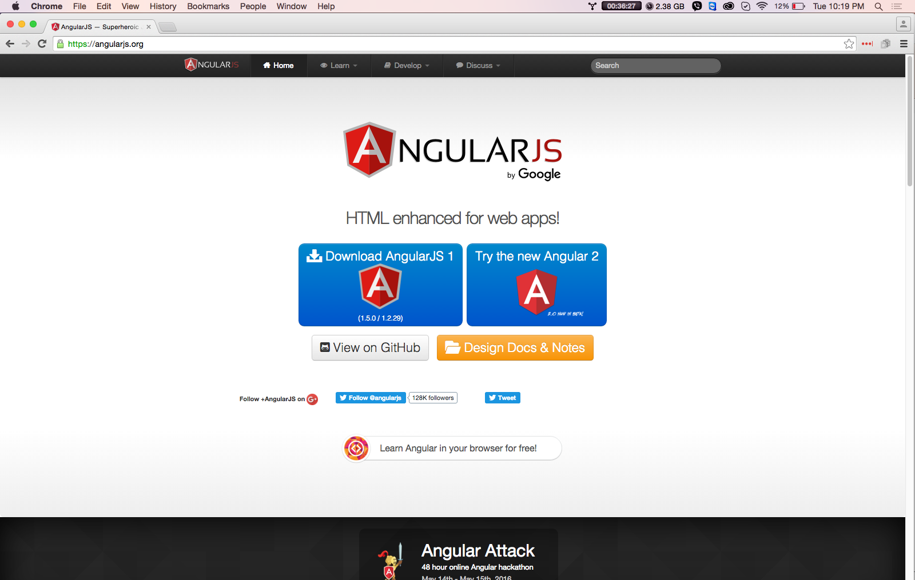
Downloading Angular.js
Go to:
https://angularjs.org

Slide 71
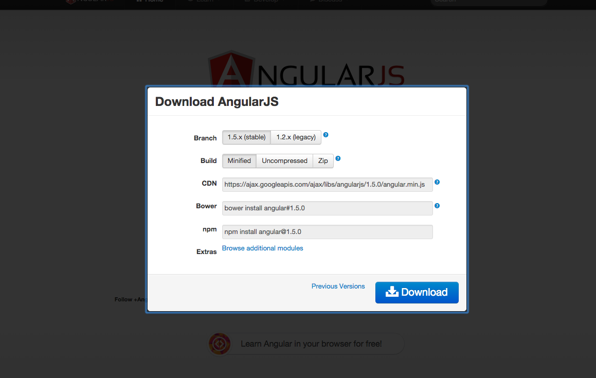
Downloading Angular.js
Stable
Minified
Local Development

Slide 72
MVC Architecture
Model
View
Controller
Notes:
Modern Javascript use an OO Approach to programming – MVC
Models – Data, Information, JSON or DB
Views – Templates {{ }}
Controllers – Glue that ties Models and Views

Slide 73
Working with Models

Slide 74
Working with $http service
Reading a JSON File

Slide 75
Using Filters
Filtering content using directives & Binding to input fields through filters

Slide 76
Working with Partials

Slide 77
THIS IS A SLIDE TITLE
Here you have a list of items
And some text
But remember not to overload your slides with content
You audience will listen to you or read the content, but won’t do both.

Slide 78

YOU CAN ALSO SPLIT YOUR CONTENT
Black
Is the color of coal, ebony, and of outer space. It is the darkest color, the result of the absence of or complete absorption of light.
White
Is the color of milk and fresh snow, the color produced by the combination of all the colors of the visible spectrum.

Slide 79

IN TWO OR THREE COLUMNS
Yellow
Is the color of gold, butter and ripe lemons. In the spectrum of visible light, yellow is found between green and orange.
Blue
Is the colour of the clear sky and the deep sea. It is located between violet and green on the optical spectrum.
Red
Is the color of blood, and because of this it has historically been associated with sacrifice, danger and courage.

Slide 80

A PICTURE IS WORTH A THOUSAND WORDS
A complex idea can be conveyed with just a single still image, namely making it possible to absorb large amounts of data quickly.

Slide 81

USE CHARTS TO EXPLAIN YOUR IDEAS
White
Gray
Black

Slide 82
USE INFOGRAPHICS TO SHOW DATA
87%
Enter text here.
50%
Enter text here.
55%
Enter text here.
88%
Enter text here.
30%
Enter text here.
Diagram featured by http://slidemodel.com

Slide 83
OR DIAGRAMS TO EXPLAIN COMPLEX IDEAS
Insert your desired
text here.
Insert your desired
text here.
Insert your desired
text here.
Insert your desired
text here.
Insert your desired
text here.
Diagram featured by http://slidemodel.com

Slide 84
AND TABLES TO COMPARE DATA
 | A | B | C
Yellow | 10 | 20 | 7
Blue | 30 | 15 | 10
Orange | 5 | 24 | 16

Slide 85

MAPS
our office

Slide 86

89,526,124
Whoa! That’s a big number, aren’t you proud?

Slide 87
89,526,124$
185,244 users
100%
That’s a lot of money
And a lot of users
Total success!

Slide 88
OUR PROCESS IS EASY
first
second
last

Slide 89

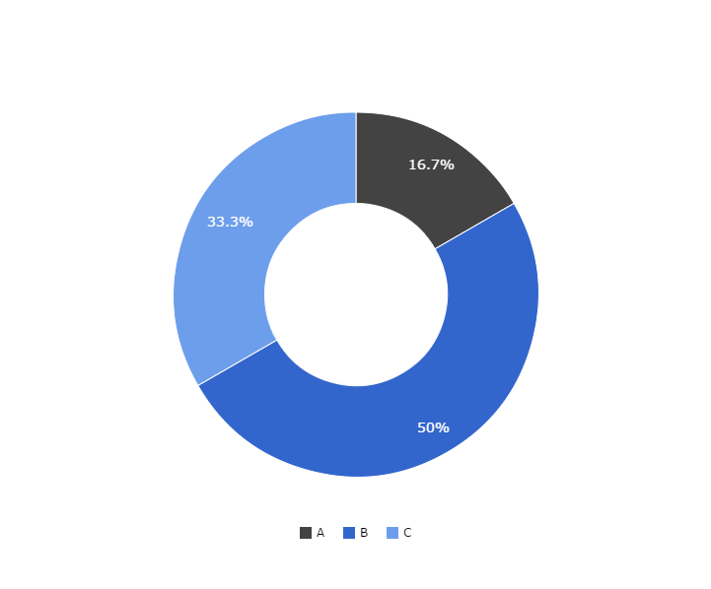
You can copy&paste graphs from Google Sheets

Slide 90
ANDROID PROJECT
Show and explain your web, app or software projects using these gadget templates.
Place your screenshot here

Slide 91
iPHONE PROJECT
Show and explain your web, app or software projects using these gadget templates.
Place your screenshot here

Slide 92
TABLET PROJECT
Show and explain your web, app or software projects using these gadget templates.
Place your screenshot here

Slide 93
DESKTOP PROJECT
Show and explain your web, app or software projects using these gadget templates.
Place your screenshot here

Slide 94
Thanks!
Any questions?
You can find me at:
@username
user@mail.me

Slide 95
CREDITS
Special thanks to all the people who made and released these awesome resources for free:
Presentation template by SlidesCarnival
Photographs by Death to the Stock Photo (license)

Slide 96

Presentation design
This presentations uses the following typographies and colors:
Titles & body copy: Muli
You can download the font on this page:
https://www.google.com/fonts#UsePlace:use/Collection:Muli:300,400,400italic,300italic
Click on the “arrow button” that appears on the top right
White #FFFFFF
Blue #00B2FF
You don’t need to keep this slide in your presentation. It’s only here to serve you as a design guide if you need to create new slides or download the fonts to edit the presentation in PowerPoint®

Slide 97
SlidesCarnival icons are editable shapes.
This means that you can:
Resize them without losing quality.
Change line color, width and style.
Isn’t that nice? :)
Examples:

